Slide 1
Cellular automata for sandpiles

Slide 2
Outline
Model
Steady state (critical state)
Algorithm
Simulation Parameter
Results, systematic uncertainties, comparison to literature
Outlook

Slide 3
Introduction
1/f noise present in self-organized critical systems
small perturbations lead to states of instability avalanches
properties of the systems are independent of initial configuration

Slide 4
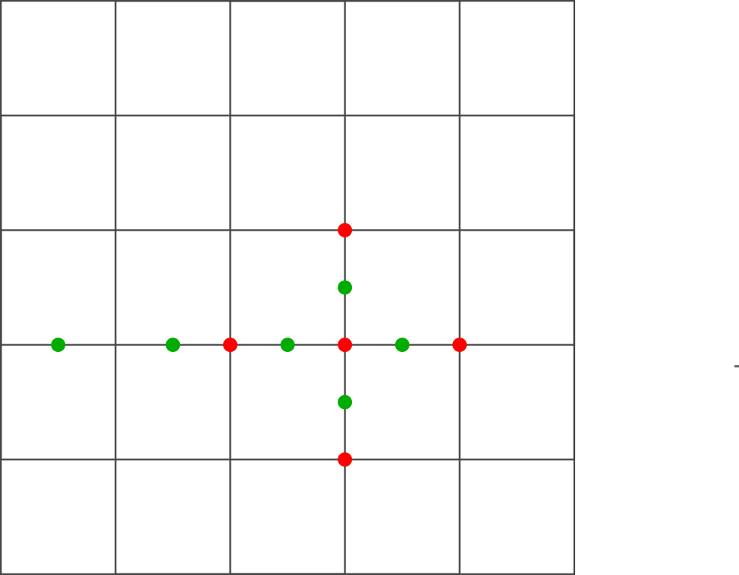
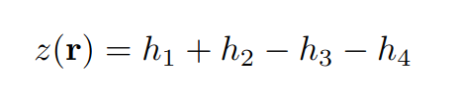
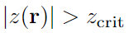
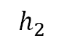
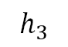
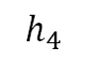
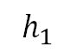
Cellular automaton
d-dimensional grid
Grid size N
Assign integer value z(r) to each point
Average slope:
Relax grid if:
$$h_{3}$$
$$h_{1}$$
$$h_{4}$$
$$h_{2}$$
Notes:
M

Slide 5
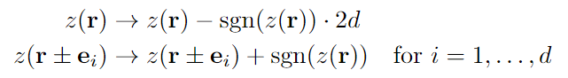
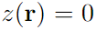
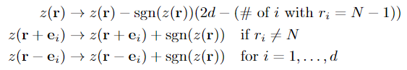
Relaxation and boundary conditions
Relaxation:
Closed boundaries: on boundaries
Open boundaries:
on boundaries, where
+1
+1
-4
+1
+1
Notes:
M

Slide 6
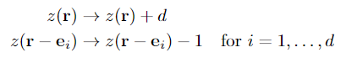
Perturbation mechanism
Random perturbations of the system
Conservative perturbation:
-1
+2
+1
+1
-1
Notes:
M

Slide 7
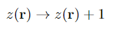
Perturbation mechanism
Random perturbations of the system
Conservative perturbation:
Non conservative perturbation:
+1
+1
+1
+1
Notes:
M

Slide 8
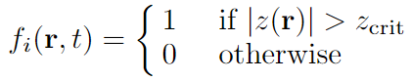
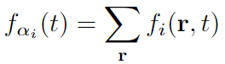
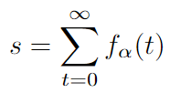
Derived quantities - I
Indicator function:
Instantaneous dissipation rate:
Total dissipation
Notes:
M

Slide 9
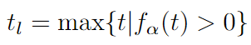
Derived quantities - II
Lifetime:
Linear spatial size:

Slide 10
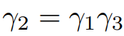
Distributions
Scaling relations:
Conditional expectation values:
Also:
Notes:
M

Slide 11
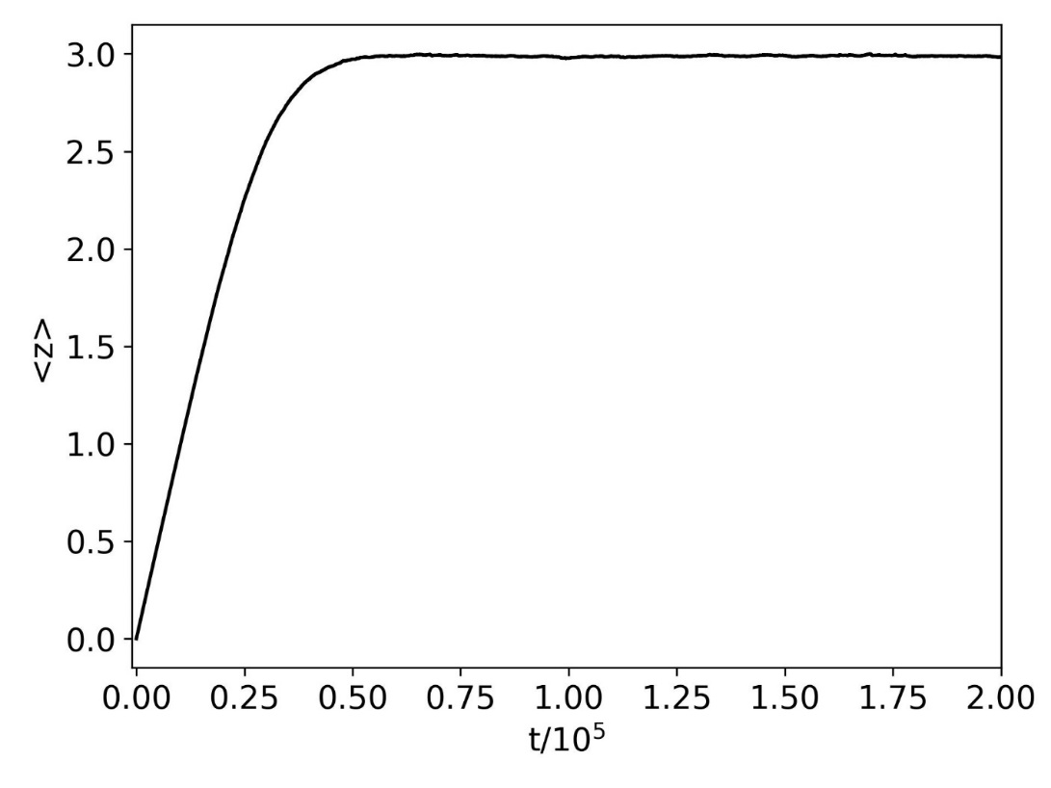
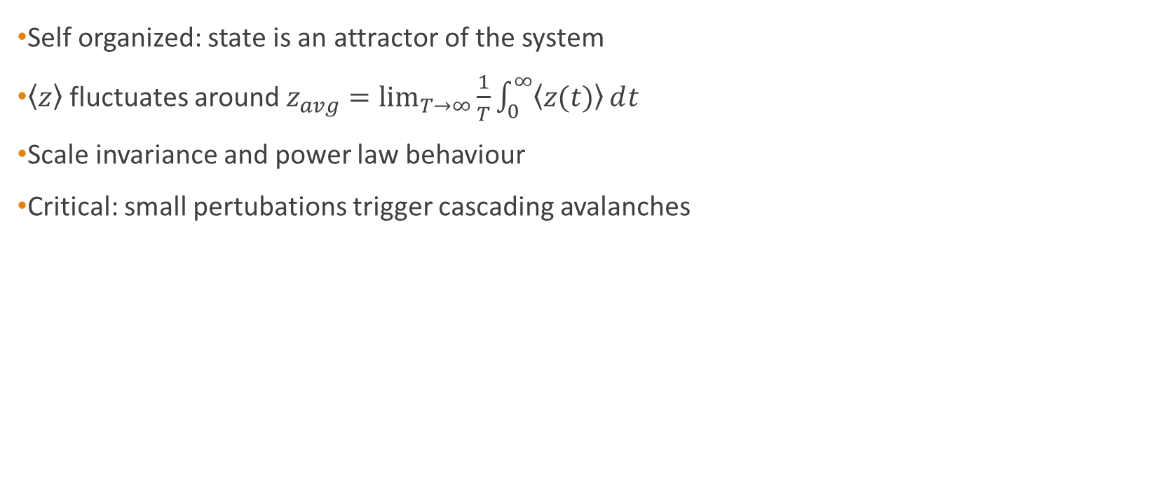
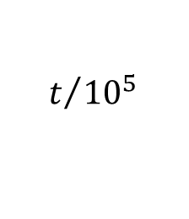

Steady state (crtitical state)
Self organized: state is an attractor of the system
$\left\langle z\right\rangle$ fluctuates around $z_{avg}=\lim_{T→∞}{\frac{1}{T}\int_{0}^{∞}{\left\langle z(t)\right\rangle ⅆt}}$
Scale invariance and power law behaviour
Critical: small pertubations trigger cascading avalanches
$$\left\langle z\right\rangle$$
$$t/{{10}^{5}}$$
Notes:
S

Slide 12
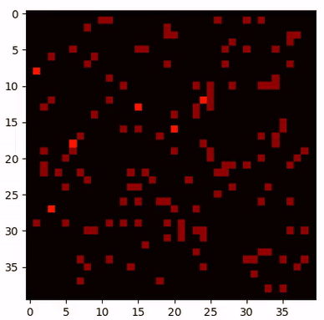
Steady state (crtitical state)
2 dimensions
40x40 lattice
Critical value of 4
Notes:
S

Slide 13
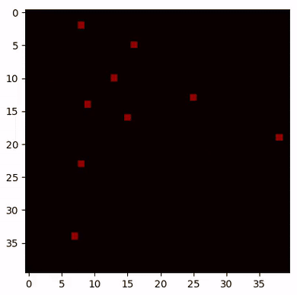
Steady state (crtitical state)
2 dimensions
40x40 lattice
Critical value of 4
Notes:
S

Slide 14
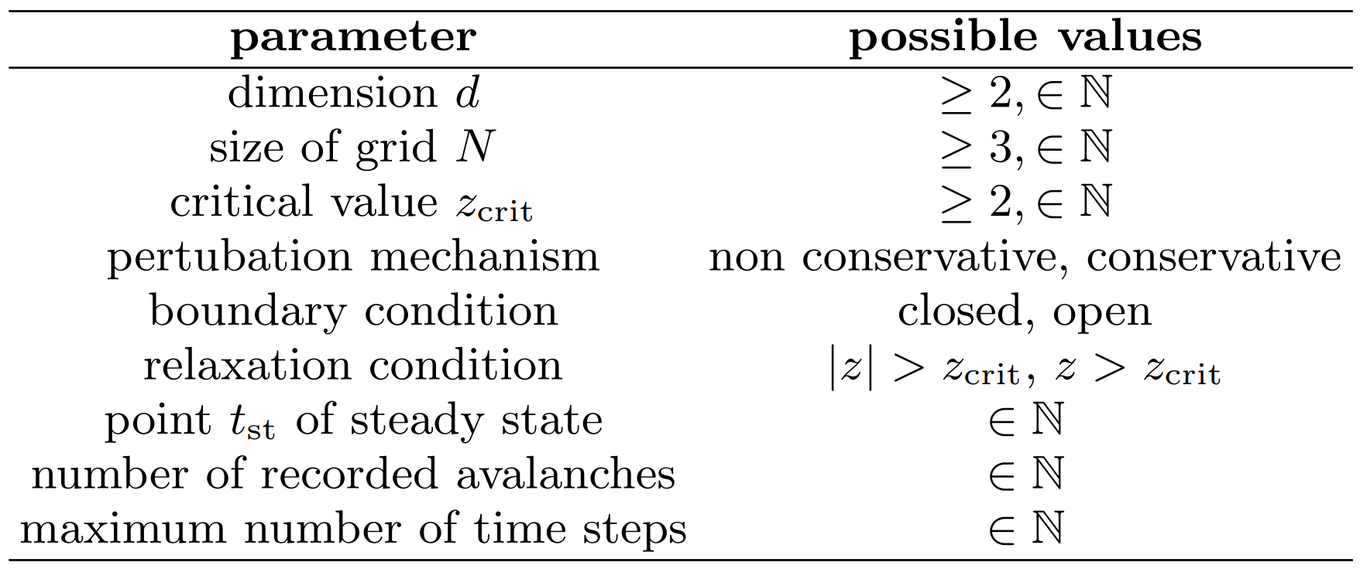
Algorithm
Notes:
S

Slide 15

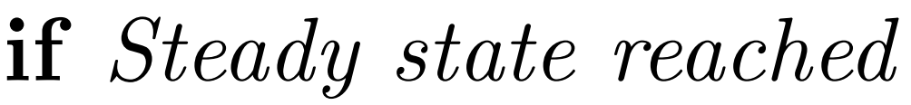
Algorithm
Notes:
S

Slide 16
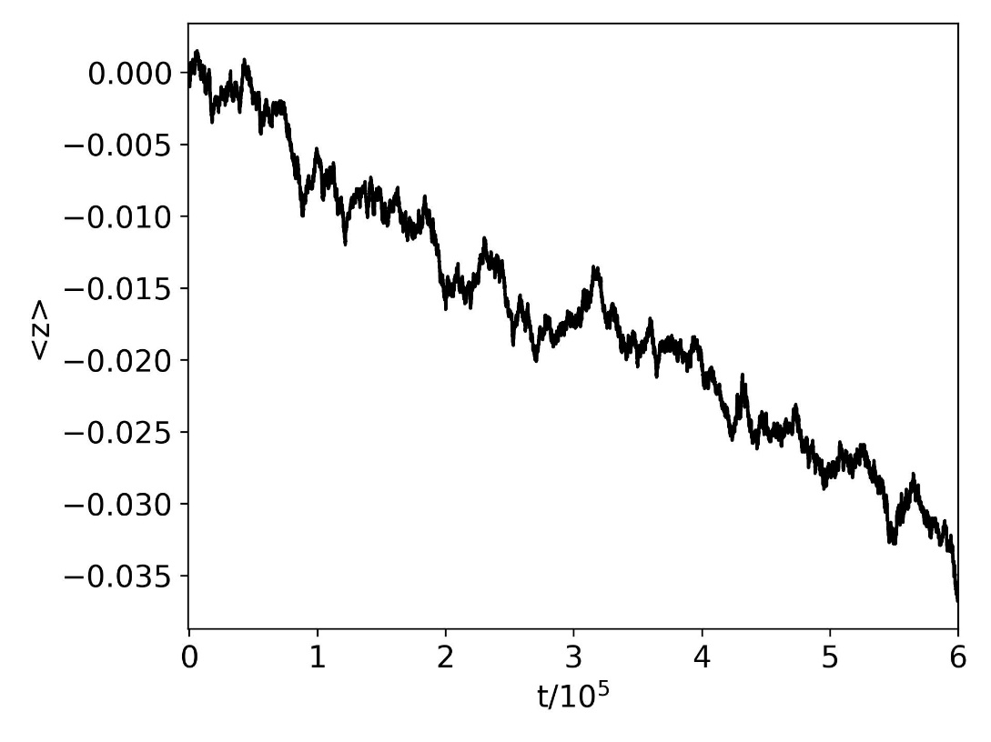
Parameter selection
Non conservative
Closed boundary
Conservative
Closed boundary
Non conservative
Closed boundary
Non conservative
Closed boundary
Notes:
S

Slide 17
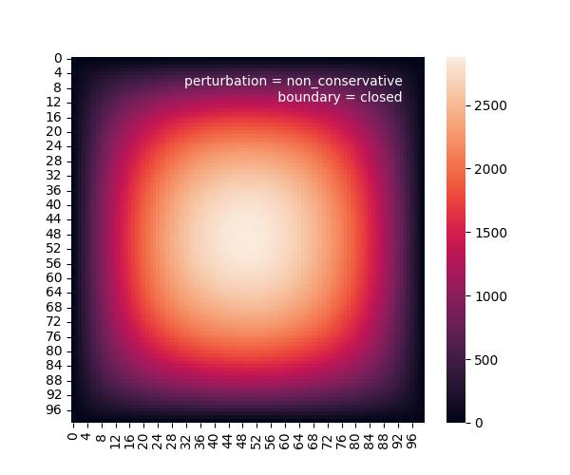
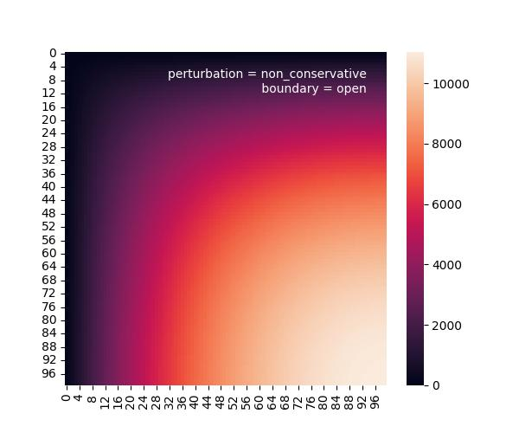
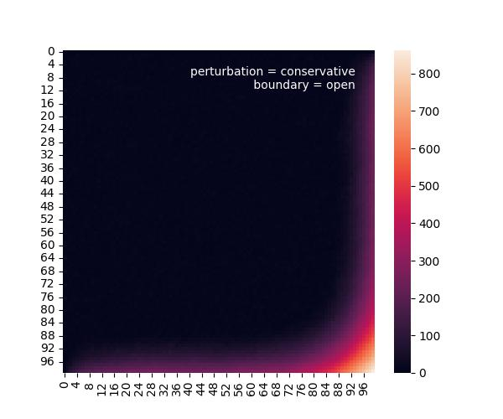
Parameter selection
Non conservative
Closed boundary
Non conservative
Open boundary
Conservative
Open boundary
Non conservative
Closed boundary
Non conservative
Closed boundary
Non conservative
Closed boundary
Notes:
S

Slide 18
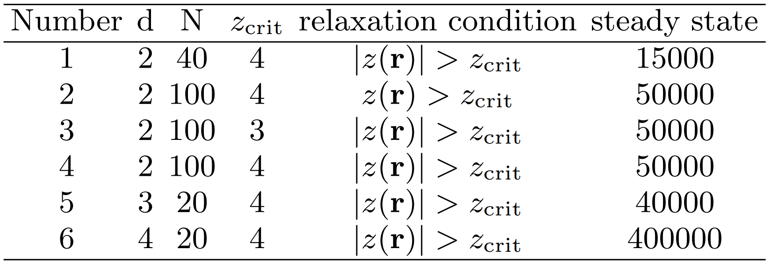

Simulations
Notes:
S

Slide 19
Simulations
Independent of model parameter
Notes:
S

Slide 20
Simulations
Dependency on dimension
Notes:
S

Slide 21
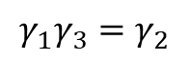
Results
$$γ_{1}γ_{3}=γ_{2}$$
For 2, 3 and 4 dimensions

Slide 22
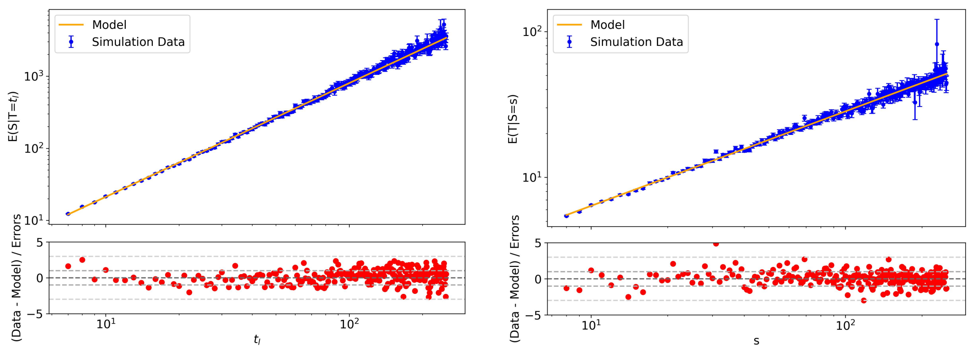
Results (2d)

Slide 23
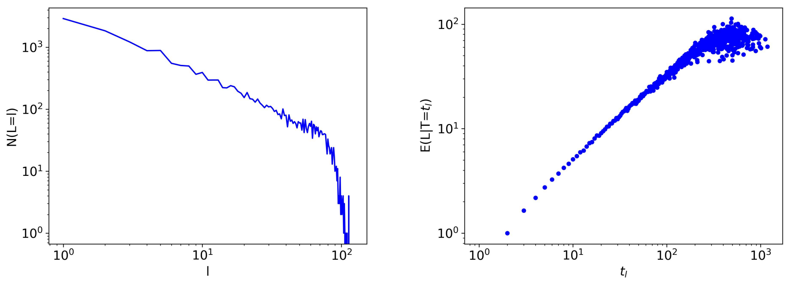
Systematic uncertainties
Finite grid size
Notes:
S

Slide 24
Systematic uncertainties
Finite grid size
Discrete lattice
Notes:
S

Slide 25
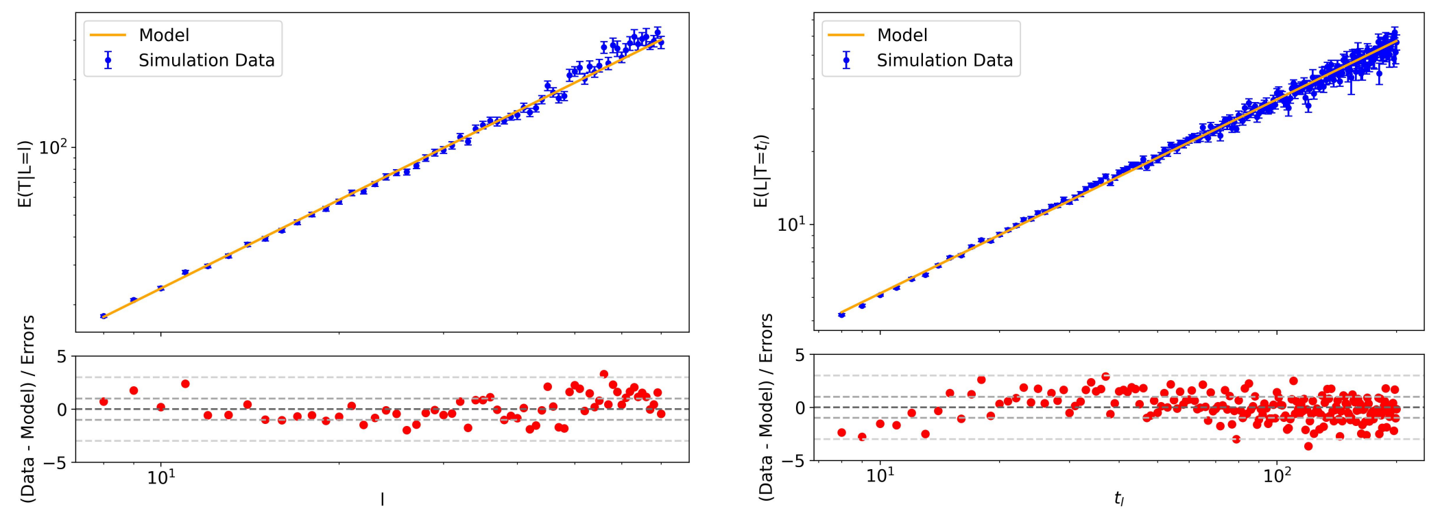
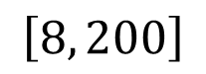
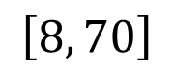
Systematic uncertainties
$$\left[8, 70\right]$$
$$\left[8, 200\right]$$

Slide 26
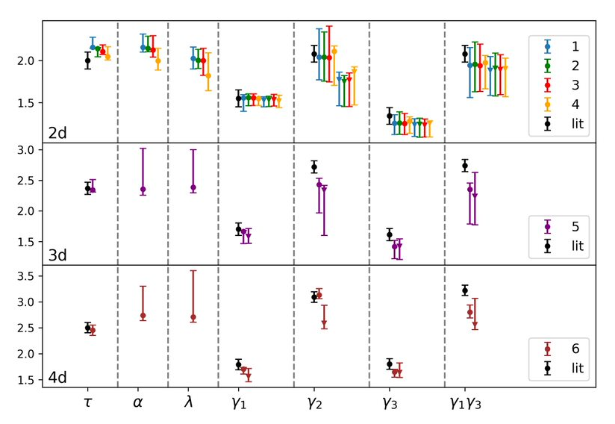
Results
Coefficients independent of scale
Coefficients dependent on dimensions
Reciprocal relation validated
Systematic deviation from literature

Slide 27
Summary
behavior of sandpiles using cellular automata
Determined critical exponents, verified reciprocal relationsships
Results are consistent with literature when considering systematic uncertainties
System automatically evolves into critical state
Critical exponents only depend on dimension of the system

Slide 28
Outlook
1) Reduce systematic uncertainties:
Use lattices of larger size N, record more avalanches
Systematically determine range where discreteness plays a role
2) Power spectrum:
Proposed: indenpendent of dimension
Data Analysis and Parameter optimization needs to be done

Slide 29
